Slide 1

Week 1 Why learn CT?

Slide 2
A definition of CT
“The thought processes involved in formulating problems and their solutions so that the solutions are represented in a form that can be effectively carried out by an information-processing agent” (Wing, 2006)

Slide 3
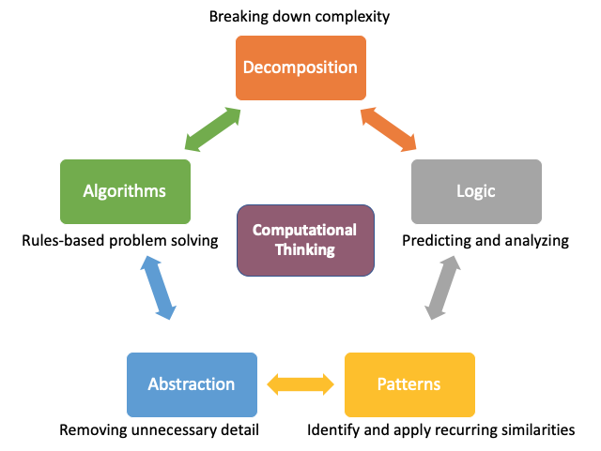
Components of CT

Slide 4
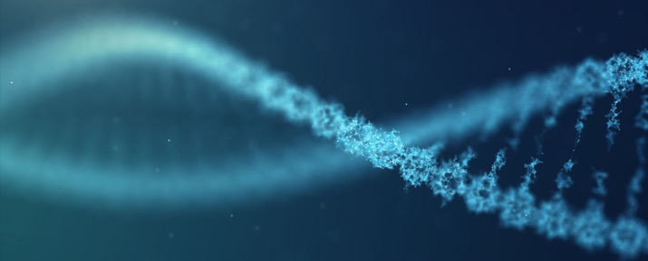
Biology is a computer science

Slide 5
Abstraction
From the full structure to…
just the letters signifying the bases

Slide 6
Decomposition
Protein folding levels is a natural example of decomposition

Slide 7
Algorithm
Binding
Recognition
Sequence extension
Next

Slide 8
Patterns
Mutation may fuzzify the DNA binding motifs, but given enough observations, we can still recover those patterns

Slide 9
Logic
If A and B, C happens
If A and D, C does not happen
If A, a bit of C happens
If A, B and D, C does not happen

Slide 10
Cells as computers
The idea that living systems could be understood and described as information-processing systems has been around even before the first computers were built (1948, von Neumann; Schrodinger, 1944)
Pondered about information storage and the possible existence of a logical processor within living cells
DNA is the heritable information storage (digital)
Genome transplantation experiment into recipient host cells – akin to transferring software to another computer
Cells are effectively “Turing machines” (An abstract machine with a virtual head to read and write symbols structured in words (sequences) from an infinite tape, focusing on one symbol at a time) e.g. ribosome

Slide 11
Object-oriented programming and DNA
You will only learn about procedural programming in this class.
But it is more natural to think of data + code as objects interacting in the real world

Slide 12
DNA is an OOP object
Data is the gene (Data)
But the methods and what it can do, and when it does it, is encoded by the response elements, promoters and enhancers (Instructions/Code)

